Slide 1


Natural Language Processing
Homeworks Presentation
Leandro Maglianella - 1792507

Slide 2
Homework 1
Word-in-Context Disambiguation

Slide 3


Word-in-Context task
Given two context sentences, determine whether the indicated target words have the same meaning.
The cat eats the mouse.
Use the mouse to click on the button.
Model
False
The cat eats the mouse.
The mouse escaped from the predator.
True
NLP – Homeworks Presentation
Pagina <number>

Slide 4
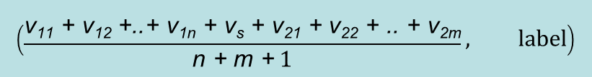
Data Pre-processing
Pre-Trained Word Embeddings: Word2Vec (English CoNLL17 corpus)
i w v
0: [PAD] padding vector v_{p}
1: [UNK] unknown vector v_{u}
2: [SEP] separator vector v_{s}
3: ‘cat’ ‘cat’ vector
4: ‘mouse’ ‘mouse’ vector
5: ..
..
Computational Natural Language Learning
40.271.169 → 100.000 words
I experimented also with GloVe 6B 300d embedding, but lower results
First approach (word-level)
Sentence1: <w₁₁ w₁₂ .. w_{1n}>
Sentence2: <w₂₁ w₂₂ .. w_{2m}>
Sentece strip len(w) > 3
Second approach (sequence encoding)
Sentence1: <w₁₁ w₁₂ .. w_{1n}>
Sentence2: <w₂₁ w₂₂ .. w_{2m}>
2
0
NLP – Homeworks Presentation
Pagina <number>

Slide 5
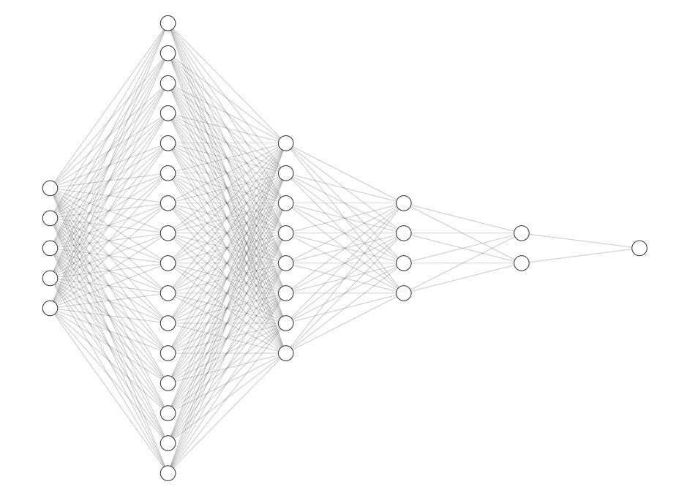
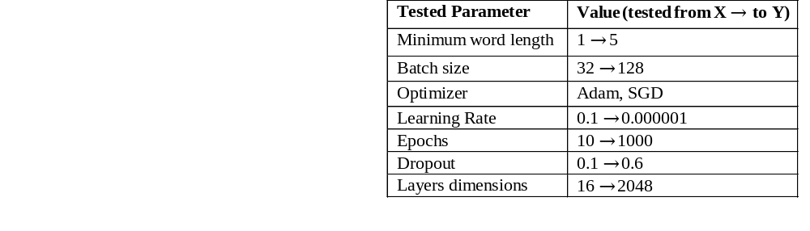
First Approach’s Model
Parameters tuning and testing
=
ReLu + DropOut
Input: (100D vector, label)
100 nodes
1024
512
256
128
1
sigmoid
NLP – Homeworks Presentation
Pagina <number>

Slide 6

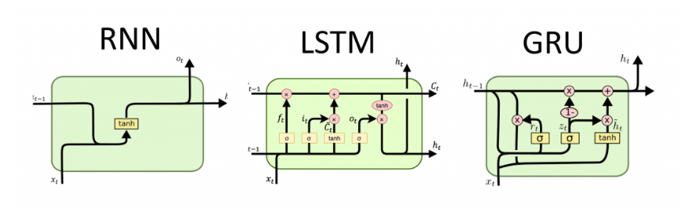
Second Approach’s Model
Input:
Embedding Layer
DropOut
RNN
GRU
LSTM → BiLSTM
RNN
GRU
LSTM
Sequence Encoder
Outputs summed, not concatenated
64 nodes
+ Variable Learning Rate
ReLu
New local maximum found → lr decreases
+ Models re-training
1
Overfitting!
sigmoid
NLP – Homeworks Presentation
Pagina <number>

Slide 7
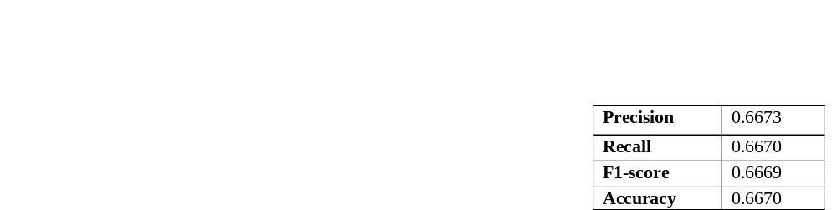
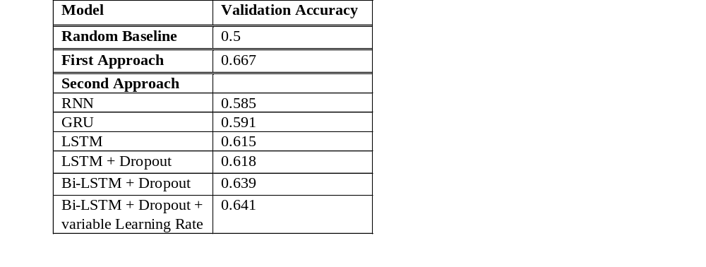
Results
Best model’s validation metrics
Models’ results (accuracy performance)
WiC Appendix
NLP – Homeworks Presentation
Pagina <number>

Slide 8
Homework 3
Word Sense Disambiguation of Word-in-Context data

Slide 9

Word Sense Disambiguation task
Given a context sentence, determine the meaning (synset identifier) of the target word.
The cat eats the mouse.
Model
mouse%1:05:00::
Click the right button of your mouse.
mouse%1:06:00::
Datasets: Unified Evaluation Framework
Training: SemCor (352 texts), SemCor_reduced (118 texts), SemCor_small (24 texts)
Validation: Concatenation of Senseval 2 and 3 and SemEval 2007, 2013 and 2015
Testing: WiC data
NLP – Homeworks Presentation
Pagina <number>

Slide 10
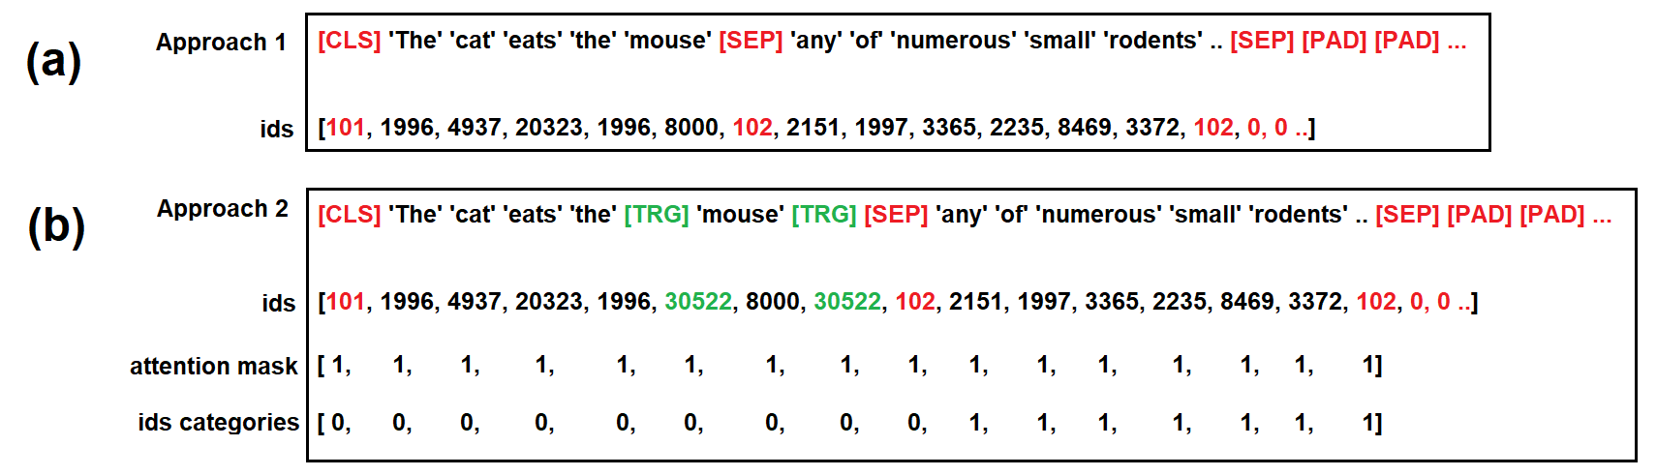
Data Pre-processing: GlossBERT
Sentence: <w₁₁ w₁₂ .. w_{1n}>
w₁₂ and POS
WordNet
Gloss1: <w₂₁ w₂₂ .. w_{2m}>
Gloss2: ..
..
For gloss in Glosses:
<[CLS] Sentence [SEP] gloss [SEP] [PAD]..>
WordPiece embedding example:
rodent → rode + ##nt
(ids, attention mask, ids categories, label)
NLP – Homeworks Presentation
Pagina <number>

Slide 11
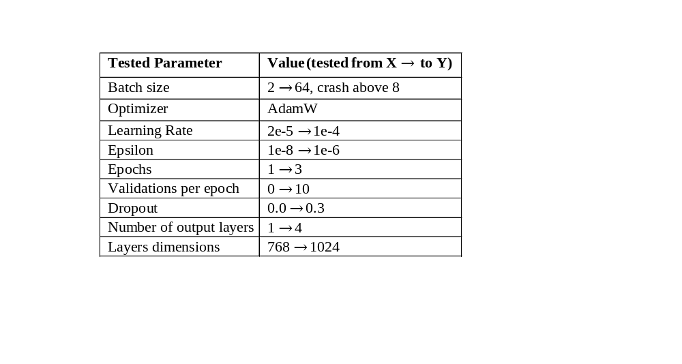
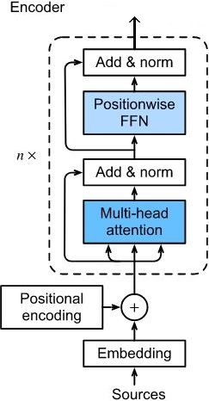
Model: BERT
Input: (ids, attention mask, ids categories, label)
BERT
DropOut
Parameters tuning and testing
768 nodes
DropOut
12 layers
12 self-attention heads
768 hidden size
110 million parameters
384 nodes
DropOut
+ Models re-training
Overfitting!
1
softmax
NLP – Homeworks Presentation
Pagina <number>

Slide 12
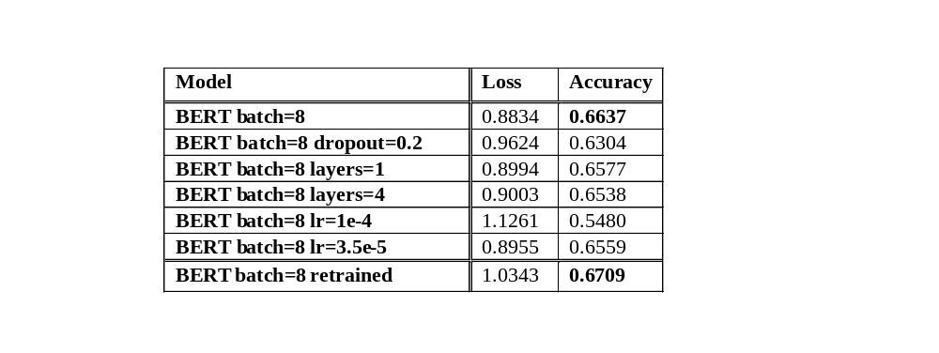
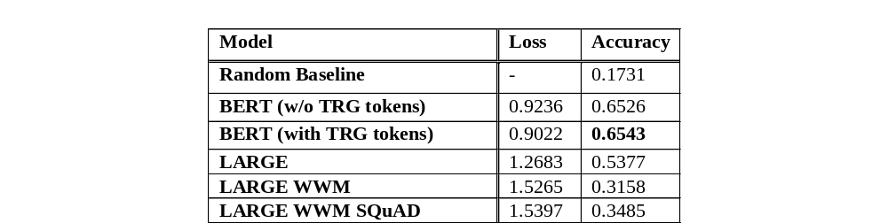
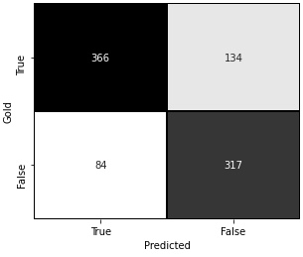
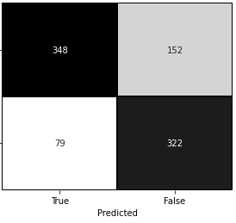





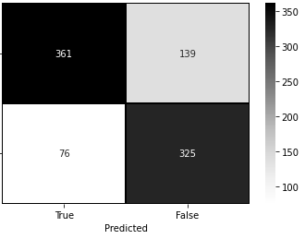


Results
Models’ results on WSD task on the test dataset (Experimental Stage 1)
Models’ results on WSD task on the test dataset (Experimental Stage 2)
* 0.6458 on secret test
Confusion matrices of bert-base-uncased batch=4 (a), batch=8 dropout=0.2 (b), batch=8 lr=3.5e-5(c), batch=8 (d) and batch=8 retrained (e) on the WIC task
NLP – Homeworks Presentation
Pagina <number>

Slide 13
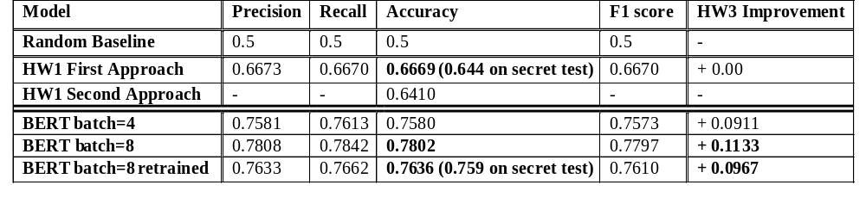
HW1 and HW3 Results Comparation
HW1 and HW3 models’ results on WIC task on the test dataset
WSD Appendix
NLP – Homeworks Presentation
Pagina <number>

Slide 14
Appendix
HW1 and HW3

Slide 15
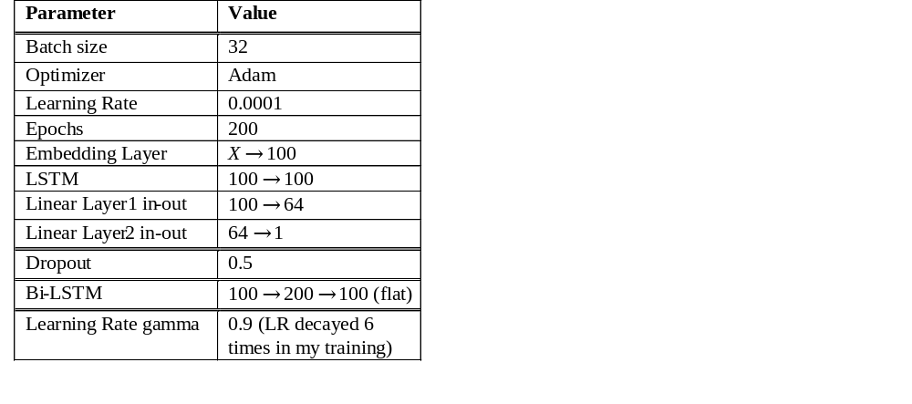
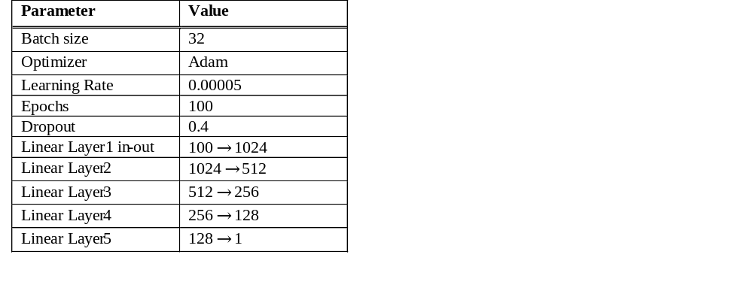
WiC Appendix
Parameters tuning and testing
First approach’s parameters
Second approach’s parameters
NLP – Homeworks Presentation
Pagina <number>

Slide 16
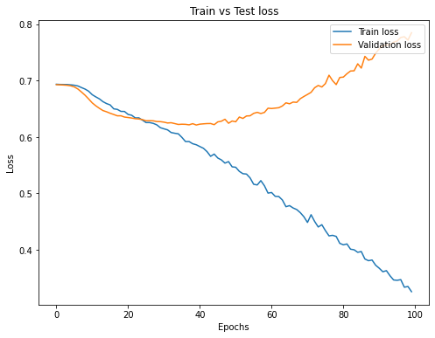
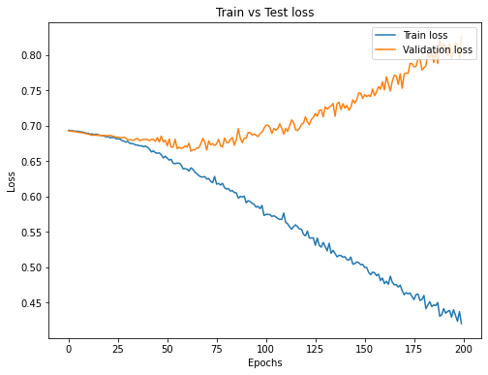
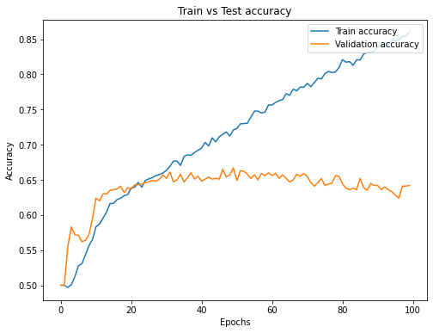
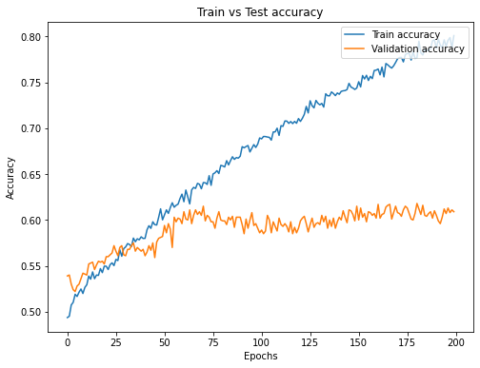
WiC Appendix
First Approach
LSTM
NLP – Homeworks Presentation
Pagina <number>

Slide 17
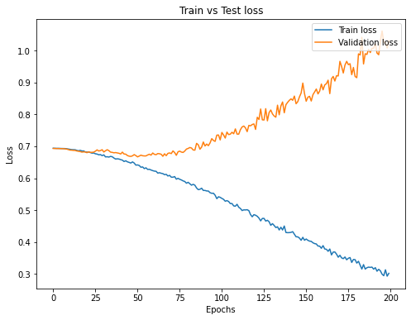
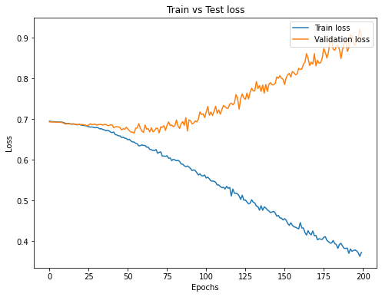
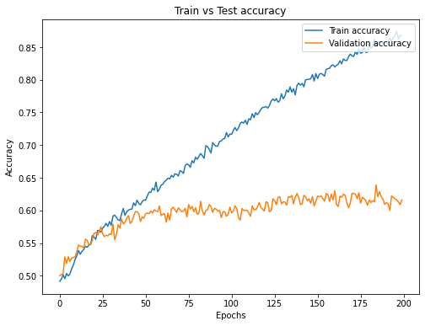
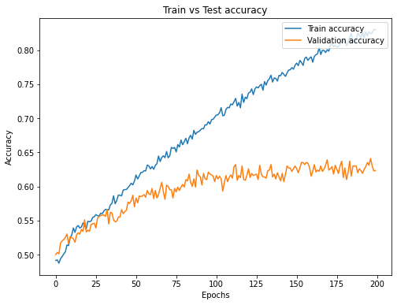
WiC Appendix
BiLSTM
BiLSTM + variable LR
Back
NLP – Homeworks Presentation
Pagina <number>

Slide 18
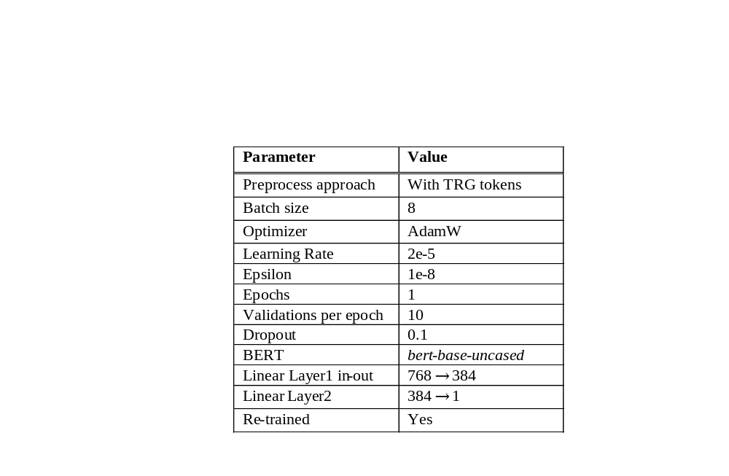

WSD Appendix
Parameters tuning and testing
Best model’s parameters
NLP – Homeworks Presentation
Pagina <number>

Slide 19
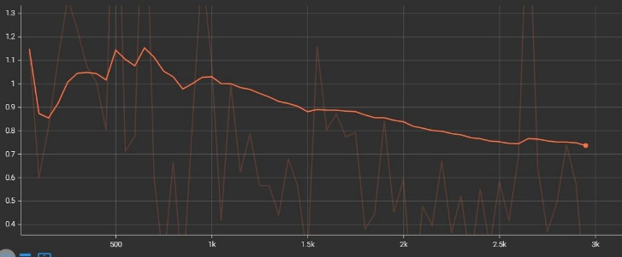
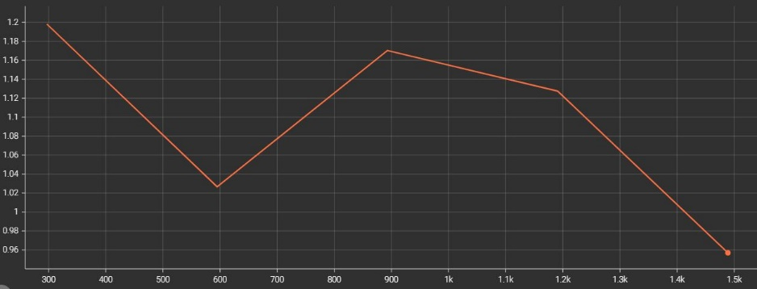
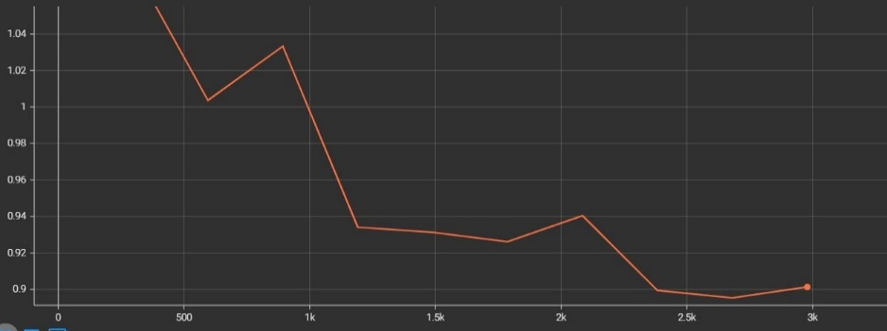
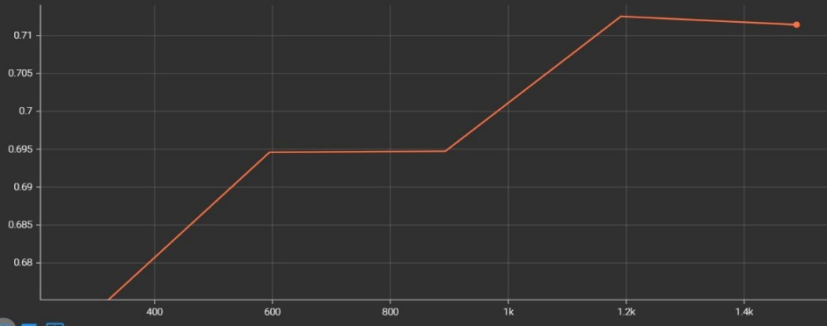
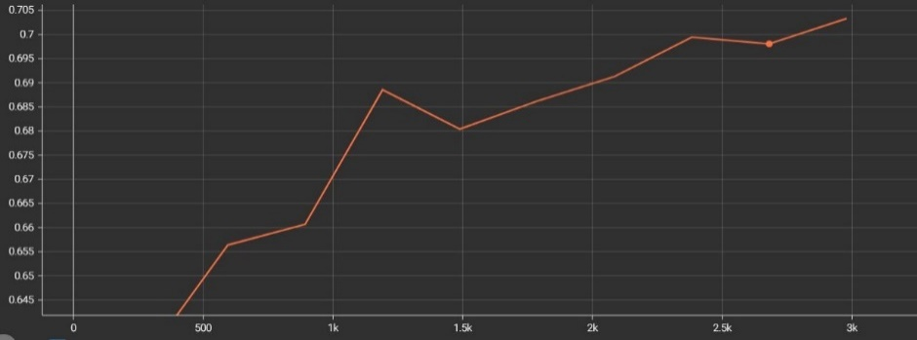
WSD Appendix
Validation loss (a) and validation accuracy (b) of bert-base-uncased-batch=8 retrained
Train loss (a), validation loss (b) and validation accuracy (c) of bert-base-uncased-batch=8
Back
NLP – Homeworks Presentation
Pagina <number>

